Slide 1
Environment & health - thermal power plants emitting toxic gases & mitigation
Dr Dipankar Saha
Ex-Additional Director, CPCB, Delhi
Ex-Member, EAC, MoEF&CC, New Delhi
dsaha.cpcb@gmail.com
August 17, 2022

Slide 2
Key words
Environment: Balanced, Offer Support services for our survival and prosperity
Health: Happiness, wellness
Thermal power plants: Stored energy is converted into dynamic or flowing energy.
Emitting: Emissions is part and parcel of any burning
Toxic gases: All emissions are toxic in nature, magnitude / potential to create impact varies with time and space.

Slide 3
Power sector in India
Installed power generation capacity of India: 434 GW
Share of thermal power plant ITPP): 67%. (230 GW)
Share of coal based power plant: 225 GW (89% in TPP)
About 194 Coal & Lignite based thermal power plants in India
Coal consumption is about 700 Million Tons Per Annum (MTPA)
Ash content in coal varies from 34% to 48%
Approx 275 MTPA coal ash is generated in India.
Approx 7300 Tons/day of Particulate Matter (PM), 20000 TPD of SO2, 15000 TPD of NOx and 300 kg/Day of Mercury emissions from coal based power plant in India

Slide 4
Power generation in India.

Slide 5
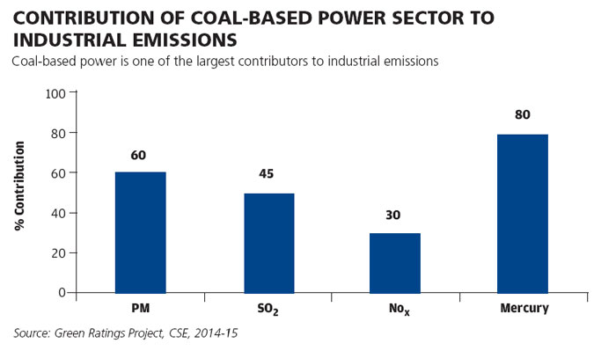

Slide 6
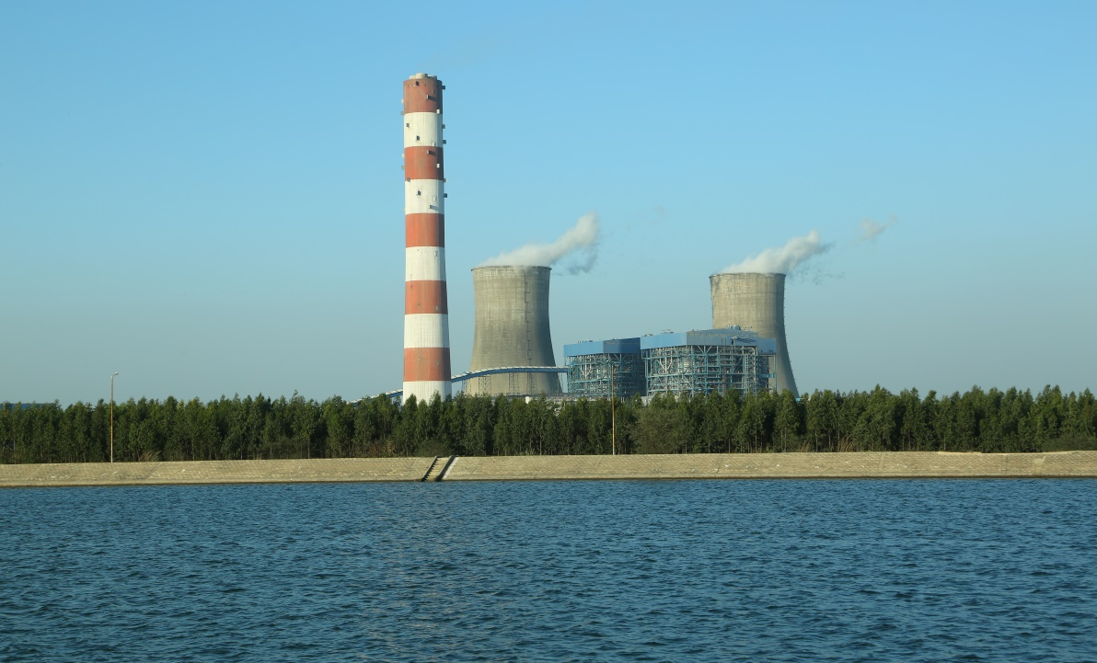
Coal based TPP

Slide 7
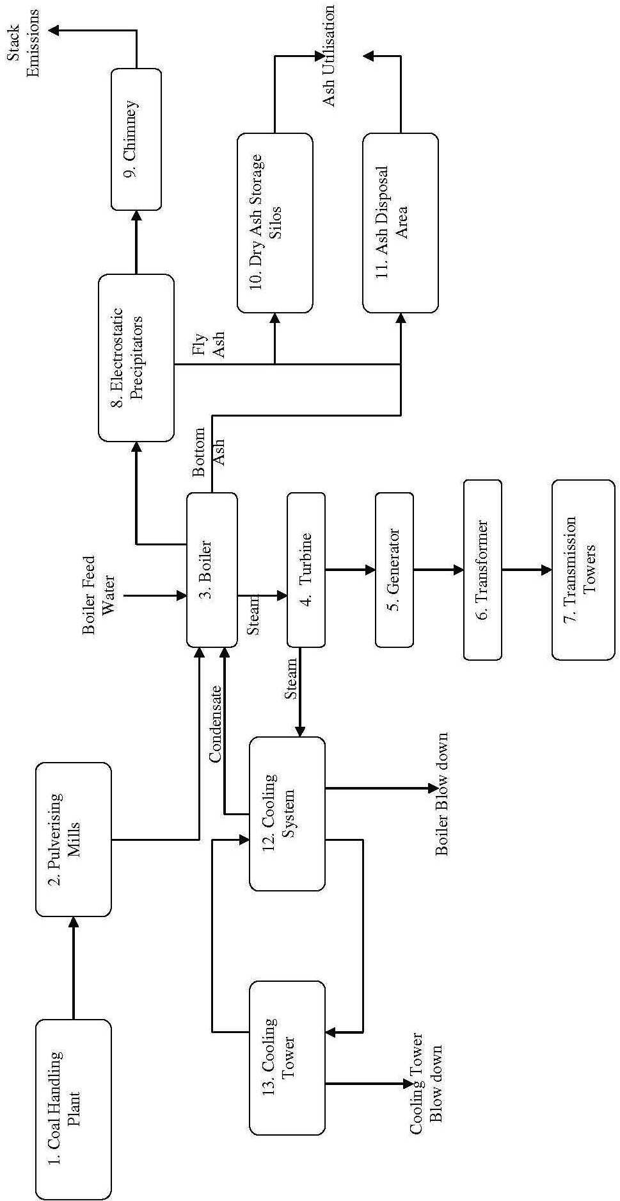
Coal based TPP: Process

Slide 8
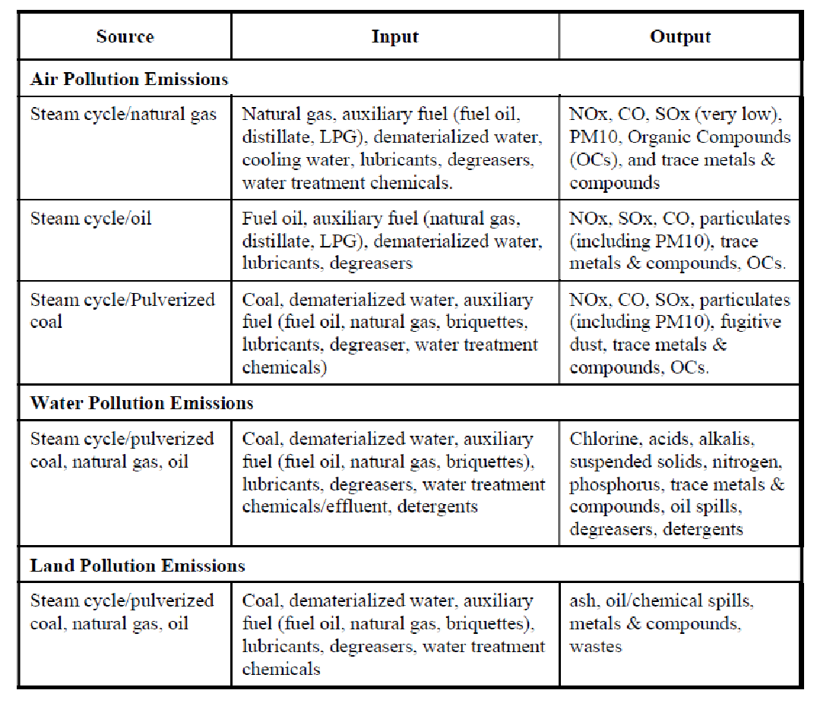
Pollution from TPP

Slide 9
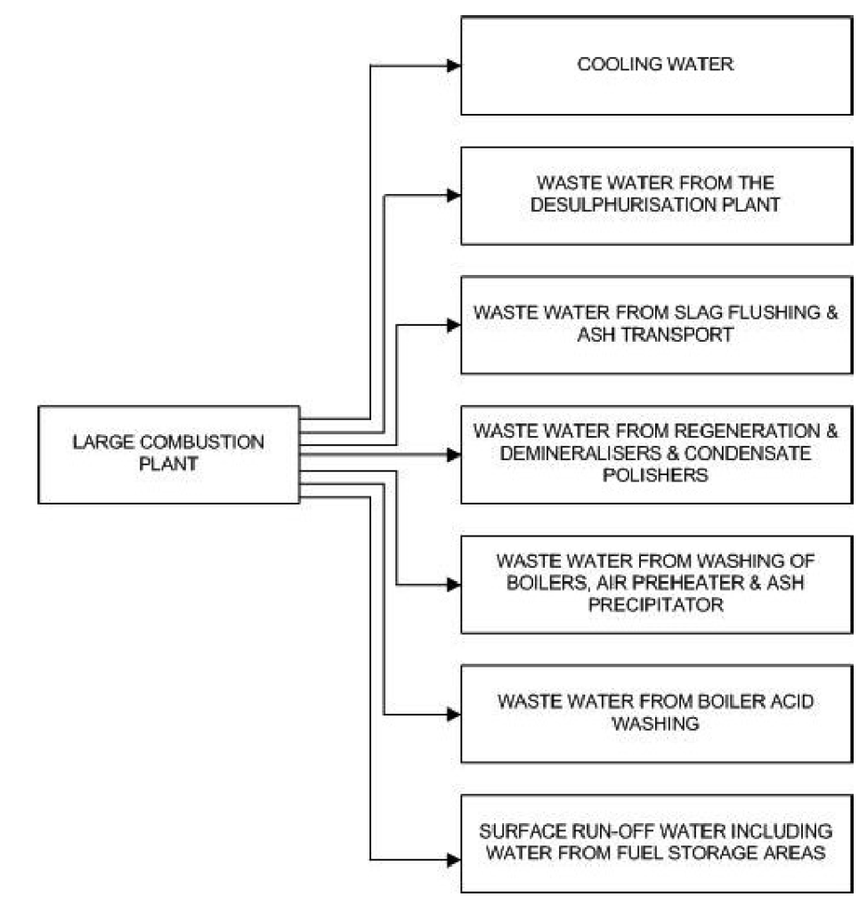
Wastewater from TPP

Slide 10
Water Requirement in TPP (4 x 660 MW)
Plant Water Usages | Water Requirement (m³/hr) | Type of Water
Makeup for CW System | 6120 | Clarified Water & Boiler Blow down
Make up to Boiler | 130 | Demineralized Water
HVAC System | 200 | Clarified
Potable Water | 250 | Pot Clarified, Filtered and Chlorinated
Makeup to AHS cooling system | 50 | Clarified
CHP & Dust Suppression System | 350 | Clarified water
Ash Disposal System (Bottom Ash) | 2000 | Raw Water (once through)
Ash Disposal System (Bottom Ash) | 410 | CW blow down (Make Up)
Ash Disposal System (Fly Ash) | 900 | CW blow down
Plant Service Water | 400 | CW blow down, Clarified

Slide 11
Wastewater Management in TPP (4 x 660 MW)
Name of the Effluent Stream | Qty. before Treatment | Treatment Accorded | Qty. after Treatment | Net Qty. Discharged | Remarks
Clarifier Sludge from CW tank | 200 | None | 200 | Nil | Shall be discharged through ash slurry disposal system to bottom ash dyke
Clarifier Sludge from DM clarifier tank, Pot Clarifier Lamella clarifier etc. | 25 | None | 25 | Nil
DM Plant regeneration waste | 5 | Tank | 5 | Nil | Discharged to BA disposal system to bottom ash dyke
Boiler Blow down | 50 | None | 50 | Nil | Shall be used in CW makeup
C.T. Blow down | 1080 | None | 1080 | Nil | Entire quantity shall be used in various plant usages i.e, blow down shall be used in Fire Fighting, Make up to bottom ash handling
Plant Service Water Effluent | 400 | Clarification in Lamella Clarifier | 400 | Nil | Entire quantity left after treatment shall be recycled back in to the service water system and sludge generated shall be sent to ash disposal system
Ash Water Overflow | 2000 | Settling Pond | 2000 | Nil | Entire qty. shall be recycled back into Bottom Ash slurry disposal system
Sanitary Waste from Plant Township | 200 | Sewage Treatment Plant | 200 | Nil | Treated sewage water shall be used for plantation & horticulture purpose to maximum extent and excess will be discharged to natural drain
Total | 3960 |  | 3960 | Nil**

Slide 12
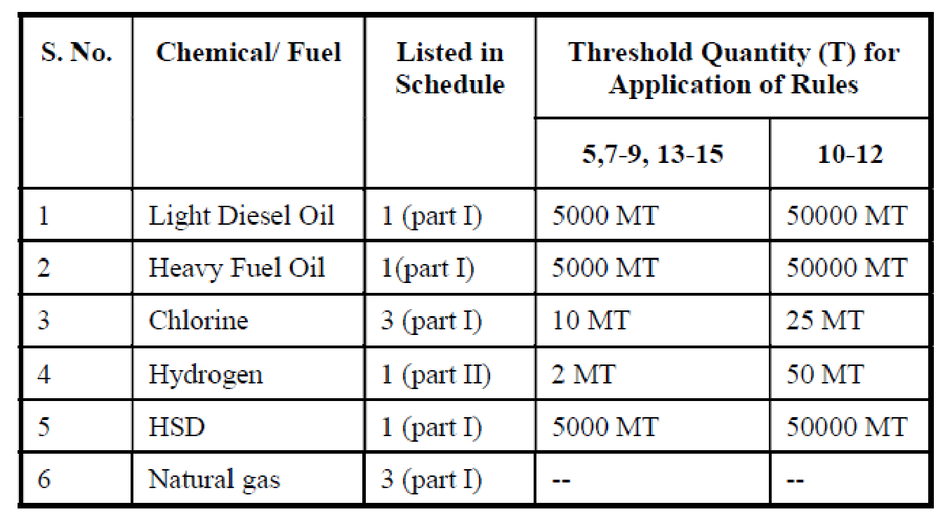
Hazardous Chemicals Storage in TPP

Slide 13
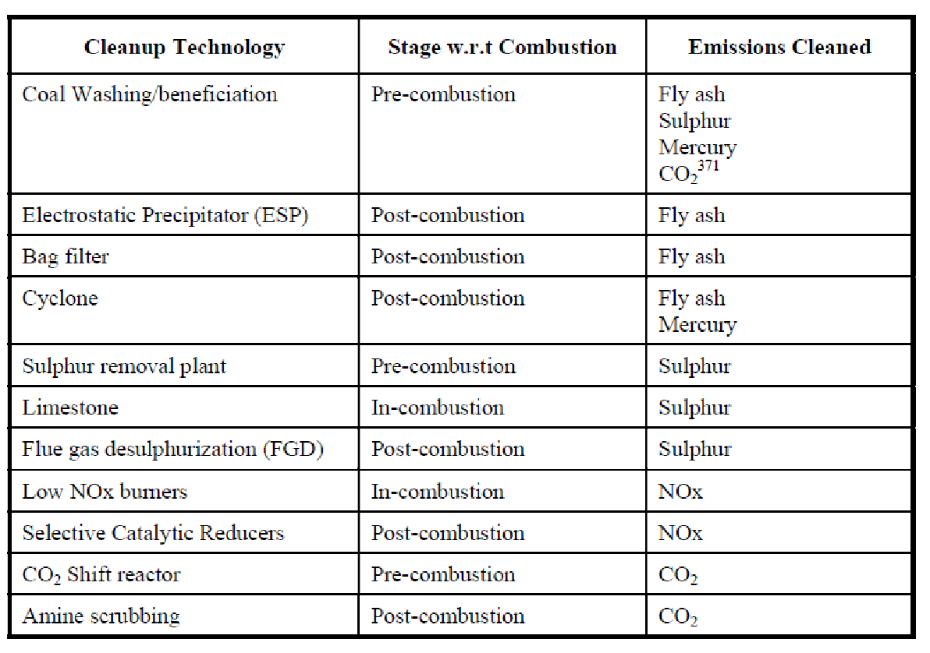
Air Pollution Control Technologies in TPP

Slide 14
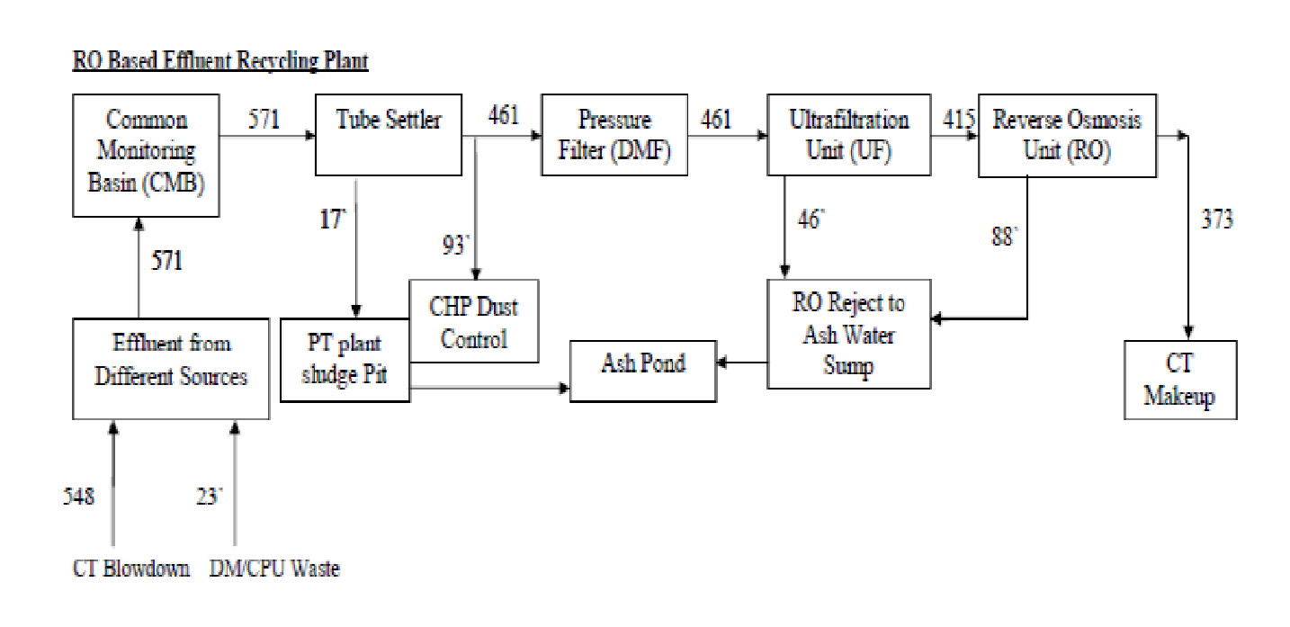
ZLD Technology in TPP (700 MW)

Slide 15
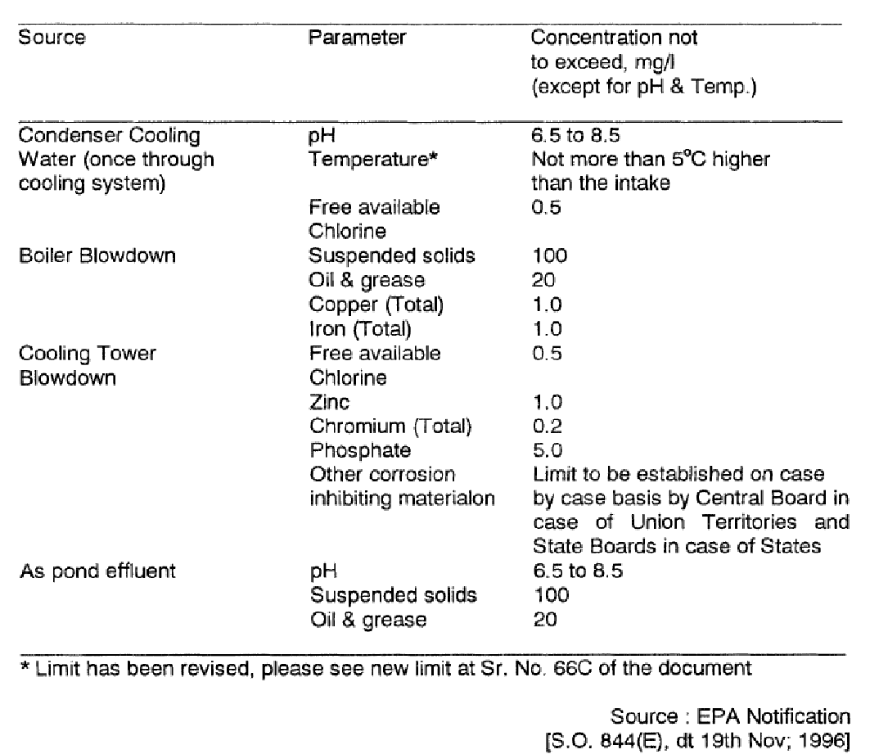
Liquid Discharge Standard in coal based TPP

Slide 16
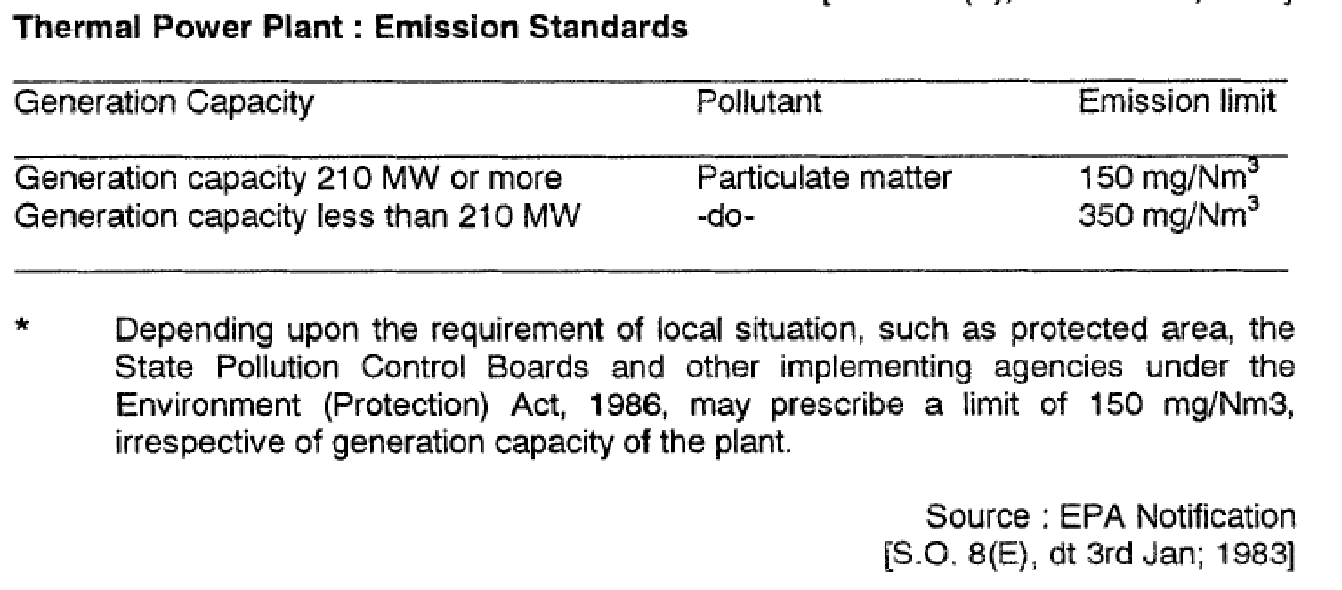
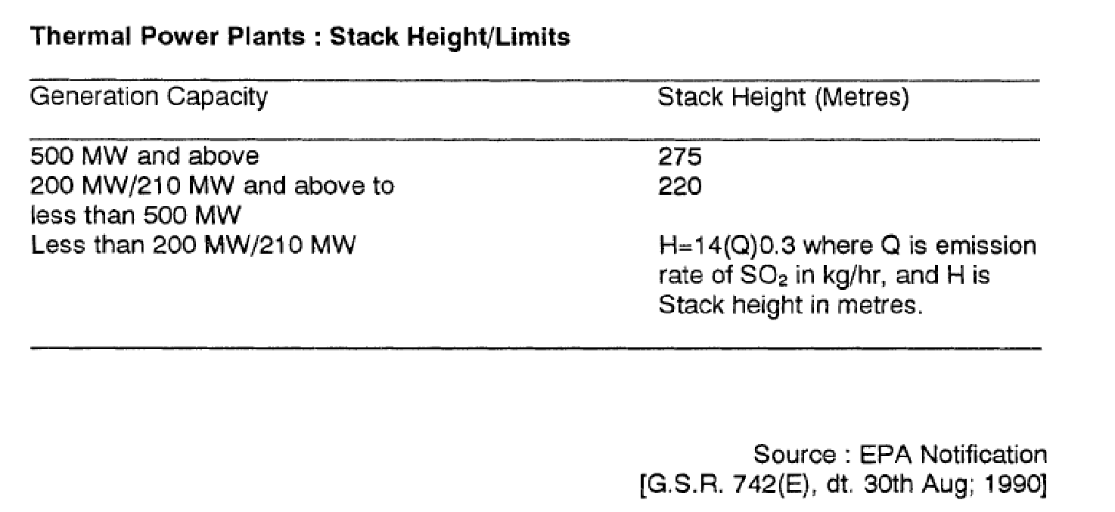
Emission Standard in coal based TPP

Slide 17
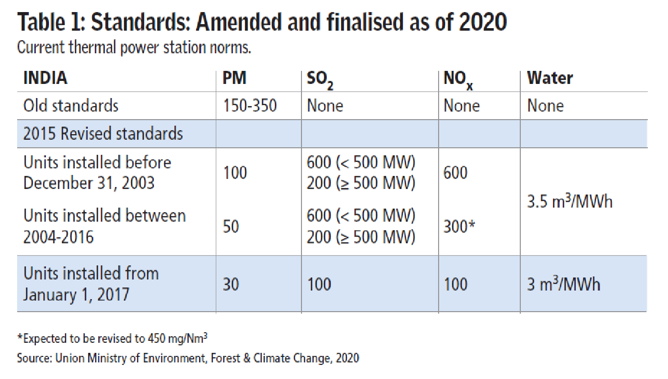
Air Emission Standards (New)

Slide 18
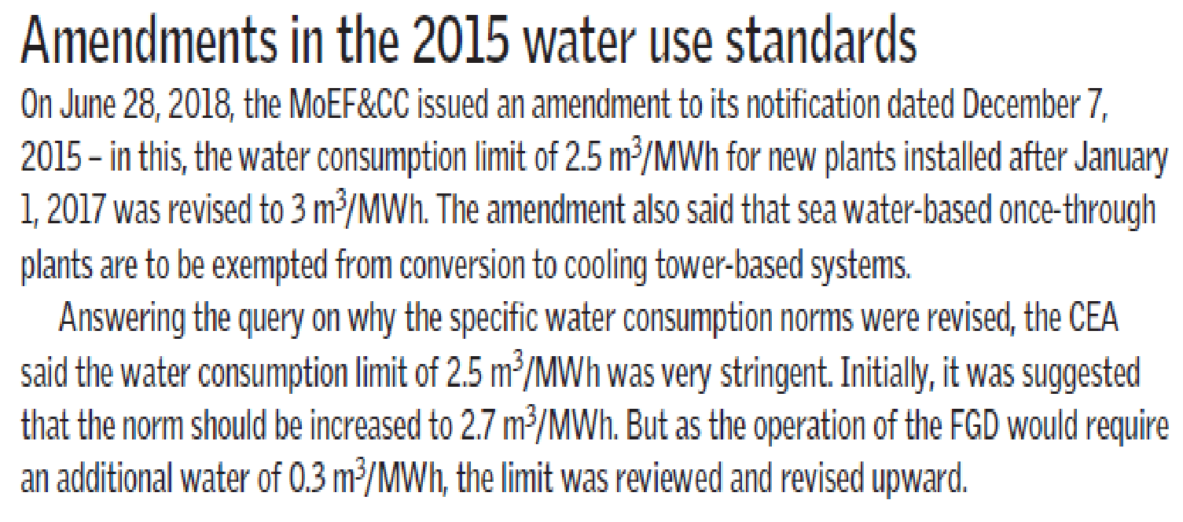
Water use standards for new Power Plants

Slide 19
Wastewater Management in CCPP (380 MW)
Uses | Water Consumption KL/hr | Effluent Generation KL/hr
Cooling water make up | 340 | 70
DM water for HRSG makeup and GT evaporative cooling | 80 | 5
Potable uses | 10 | 6
Service water (Evaporative, cooler, Air washer, etc. | 15 | 6
Misc and other uses, clarifier and Evaporation loss. | 20 | 4
Total | 455 | 91
Water required for irrigation : 60 kl/ha/day (normal sandy loam soil)

Slide 20
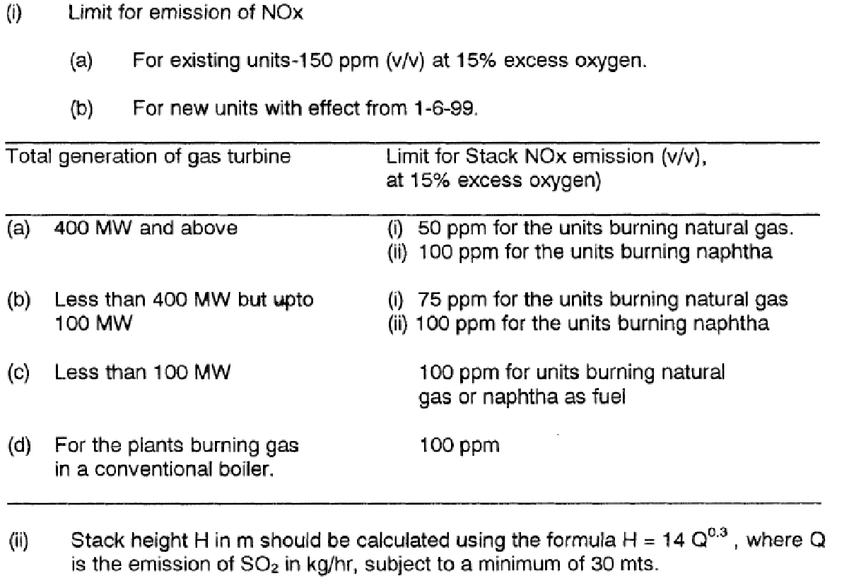
Emission Standards for gas based TPP

Slide 21
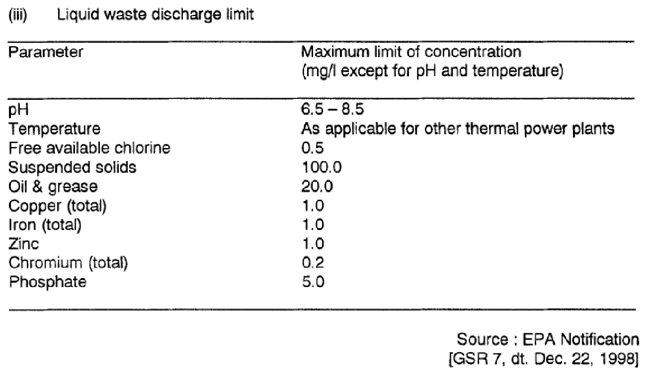
Effluent Discharge Standards for gas based TPP

Slide 22
Health Risks and Pollution Standards
Hazardous air pollutants released by coal-fired power plants can cause a wide range of health effects.
People who work at or live near coal-fired power plants have the greatest health risks from power plant pollution
Exposure to these pollutants can damage the lungs, heart, brain, eyes, skin, and breathing passages. It can affect the kidneys, and nervous systems.
In order to protect human health, health of plants and animals in our ecosystem, designated use based ambient standards were formulated.
They are National Ambient Air Quality Standards, Surface Water Quality Criteria and Standard Soil Specifications. The Impact assessment of any activity is carried out using these benchmark standards.

Slide 23
Health Effects of Pollutants
PM: There is a close, quantitative relationship between exposure to high concentrations of small particulates (PM₁₀ and PM_{2.5}) and increased mortality or morbidity, both daily and over time. Small particulate pollution has health impacts even at very low concentrations – indeed no threshold has been identified below which no damage to health is observed.
Ozone: Excessive ozone in the air can have a marked effect on human health. It can cause breathing problems, trigger asthma, reduce lung function and cause lung diseases.
NO₂: Epidemiological studies have shown that symptoms of bronchitis in asthmatic children increase in association with long-term exposure to NO₂. Reduced lung function growth is also linked to NO₂ at concentrations currently measured in cities of Europe.
SO₂: SO₂ can affect the respiratory system and the functions of the lungs, and causes irritation of the eyes. Inflammation of the respiratory tract causes coughing, mucus secretion, aggravation of asthma and chronic bronchitis and makes people more prone to infections of the respiratory tract.

Slide 24
Health Effects of Pollutants
Human Toxicity
Substance | Acute | Chronic | Comments
Arsenic | Ingestion and inhalation : affects the gastro intestinal system and central nervous system. | Known human carcinogen with high potency, Inhalation causes lung cancer, ingestion causes lung, skin, bladder and liver cancer. The kidney is affected following chronic inhalation and oral exposure.
Cadmium | Inhalation exposure causes bronchial and pulmonary irritation. A single acute exposure to high levels of cadmium can result in long-lasting impairment of lung function. | Probable human carcinogen of medium potency. The kidney is the major target again in humans following chronic inhalation and oral exposure | Other effects noted from chronic inhalation exposure are bronchio-litis and emphysema.

Slide 25
Health Effects of Pollutants
Human Toxicity
Substance | Acute | Chronic | Comments
Chromium | High exposure to chromium VI may result in rental toxicity, gastrointestinal hemorrhage and internal hemorrhage. | Known human carcinogen of high potency. | Chronic effects from industrial exposures are inflammation of the respiratory tract, effects on the kidney, liver, and gastrointestinal tract.
Mercury | Inhalation exposure to elemental mercury results in central nervous system effects and effects on gastrointestinal tract and respiratory system. | Methyl mercury ingestion causes development effects. Infants born to women who ingested methyl mercury may perform poorly on neuro behavorial tests. | Other effects noted from chronic inhalation exposure are bronchiolitis and emphysema.

Slide 26
National Ambient Air Quality Standards-2009
Pollutants | Time Weighted Average | Concentration in Ambient Air |  | Methods of Measurement
 |  | Industrial, Residential, Rural and other Areas | Ecologically Sensitive Area (Notified by Central Government)
Sulphur Dioxide (SO₂), µg/m³ | Annual * 24 Hours ** | 50 80 | 20 80 | -Improved West and Gaeke Method -Ultraviolet Fluorescence
Nitrogen Dioxide (NO₂), µg/m³ | Annual * 24 Hours ** | 40 80 | 30 80 | -Jacob & Hochheiser modified method (NaOH - NaAsO₂) Gas Phase Chemiluminescence
Particulate Matter (Size less than 10µm) or PM₁₀, µg/m³ | Annual * 24 Hours ** | 60 100 | 60 100 | -Gravimetric -TEOM -Beta attenuation
Particulate Matter (Size less than 2.5 µm) or PM_{2.5}, µg/m³ | Annual * 24 Hours ** | 40 60 | 40 60 | -Gravimetric -TEOM -Beta Attenuation

Slide 27
National Ambient Air Quality Standards-2009
Pollutants | Time Weighted Average | Concentration in Ambient Air |  | Methods of Measurement
 |  | Industrial, Residential, Rural and other Areas | Ecologically Sensitive Area (Notified by Central Government)
Ozone (O₃) µg/m³ | 8 Hours * 1 Hour ** | 100 180 | 100 180 | -UV Photometric -Chemiluminescence
Carbon Monoxide (CO), mg/m³ | 8 Hours ** 1 Hour ** | 02 04 | 02 04 | -NDIR Spectroscopy
Ammonia (NH₃), µg/m³ | Annual * 24 Hours ** | 100 400 | 100 400 | -Chemiluminescence -Indophenol blue method -Chemical method
Benzene (C₆H₆), µg/m³ | Annual * | 05 | 05 | -Gas Chromatography continuous analyzer -Adsorption and desorption followed by GC analysis

Slide 28
National Ambient Air Quality Standards-2009
Pollutants | Time Weighted Average | Concentration in Ambient Air |  | Methods of Measurement
 |  | Industrial, Residential, Rural and other Areas | Ecologically Sensitive Area (Notified by Central Government)
Benzo(a)Pyrene (BaP) Particulate phase only, ng/m³ | Annual * | 01 | 01 | -Solvent extraction followed by HPLC / GC analysis
Lead (Pb) µg/m³ | Annual * 24 Hours ** | 0.50 1.0 | 0.50 1.0 | -AAS/ICP Method after sampling on EPM 2000 filter paper -ED-XRF using Teflon filter
Arsenic (As), ng/m³ | Annual * | 06 | 06 | -AAS/ICP Method after sampling on EPM 2000 filter paper
Nickel (Ni), ng/m³ | Annual * | 20 | 20 | -AAS/ICP Method after sampling on EPM 2000 filter paper

Slide 29
Primary Water Quality Criteria for Coastal Waters
Parameter | SW-I Standards | SW-II Standards | SW-III Standards | SW-IV Standards | SW-V Standards | Rationale
pH | 6.5 to 8.5 | 6.5 to 8.5 | 6.5 to 8.5 | 6.5 to 9.0 | 6.5 to 9.0 | General Broad range
DO, mg/l | 5, or 60% saturation | 4, or 50% saturation | 3, or 40% saturation | 3, or 40% saturation | 3, or 40% saturation | Protection of aquatic life
Colour & Odour | Nil | Nil | Nil | Nil | Nil | ---
Floating matter | Nothing Obnoxious | Nothing Obnoxious | Nothing Obnoxious | --- | --- | Surfactant should not cause foam
Suspended Solids, mg/l | None from sewage or industrial origin | --- | --- | --- | --- | ---
Oil and grease, mg/l | 0.1 | --- | --- | 10 | 10 | Have effect on larvae and fish eggs
Mercury, mg/l | 0.01 | --- | --- | --- | --- | Toxic
Lead, mg/l | 0.01 | --- | --- | --- | --- | Toxic
Cadmium, mg/l | 0.01 | --- | --- | --- | --- | Toxic
Turbidity, NTU | --- | 30 | 30 | --- | --- | Measured at 0.9 m depth
Fecal Coliform, MPN/100ml | --- | 100 | 500 | 500 | 500 | ---
BOD, 3 days at 27⁰C | --- | 3 | --- | 5 | 5 | Aesthetic quality of water

Slide 30
Designated Best Use Criteria of CPCB (Surface Water)
Designated Best Use
Drinking Water Source without conventional treatment but after disinfection | A | Total Coliforms (Organism MPN/100ml shall be 50 or less) pH between 6.5 and 8.5 Dissolved Oxygen 6 mg/l or more BOD 5 days 20° C 2 mg/l or less
Outdoor bathing (Organised) | B | Total Coliforms Organism MPN/100ml shall be 500 or less pH between 6.5 and 8.5 Dissolved Oxygen 5mg/l or more BOD 5 days 20°C 3mg/l or less
Drinking water source after conventional treatment and disinfection | C | Total Coliforms Organism MPN/100ml shall be 5000 or less pH between 6 to 9 Dissolved Oxygen 4 mg/l or more BOD 5 days 20°C 3 mg/l or less
Propagation of Wild life and Fisheries | D | pH between 6.5 to 8.5 Dissolved Oxygen 4 mg/l or more Free Ammonia (as N) 1.2 mg/l or less
Irrigation, Industrial Cooling, Controlled Waste disposal | E | pH between 6.0 to 8.5 Electrical Conductivity at 25°C micro mhos/cm Max.2250 Sodium absorption Ratio Max. 26 Boron Max. 2mg/l
 | Below ‘E’ | Not Meeting A, B, C, D & E Criteria

Slide 31
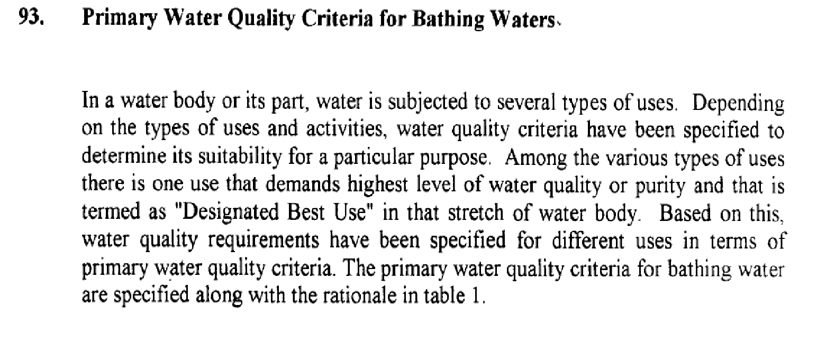
Primary Water Quality Criteria
Gazette Notification: 742E, 25 September 2000

Slide 32
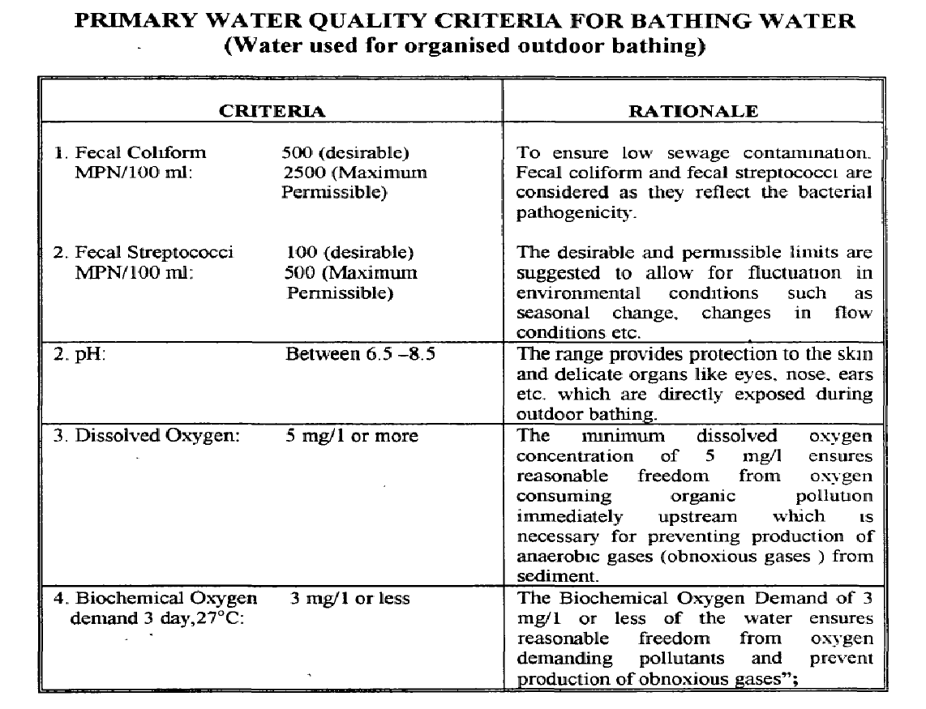
Water Quality Monitoring

Slide 33
Standard Soil Criteria
 | Parameters | Unit | Standard Classification
1 | pH (20% slurry/ saturated extract) | - | <4.5 Extremely acidic 4.51-5.00 Very strongly acidic 5.01-6.00 moderately acidic 6.01-6.50 slightly acidic 6.51-7.30 Neutral 7.31-7.80 slightly alkaline 7.81-8.50 moderately alkaline 8.51-9.0 strongly alkaline >9.01 very strongly alkaline
2 | Electrical Conductivity - EC (20% slurry / saturated extract) | mmhos/cm | >0.5 low nutrient soil 1 average soil / good 1.01-2.0 harmful to germination 2.01-3.0 harmful to crops
3 | Organic Carbon | % | Upto 0.2: very less 0.21-0.4: less 0.41-0.5: medium 0.51-0.8: on an average sufficient 0.81-1.00: sufficient >1.0 more than sufficient
4 | Sodium Absorption Ratio (SAR) (20% slurry / saturated extract) | meq/l | SAR > 13 (Sodic / Saline Soil)

Slide 34
Standard Soil Criteria
LIMIT FOR METALS IN SOIL
Name of Metals | Unit | Acceptable Range (India) | Acceptable Limit European Union
Nickel as Ni | mg/kg | 75-150 | 75
Copper as Cu | mg/kg | 135-270 | 140
Cadmium as Cd | mg/kg | 3-6 | 3
Chromium as Cr | mg/kg | - | 150
Zinc as Zn | mg/kg | 300-600 | 300
Lead as Pb | mg/kg | 250-500 | 300

Slide 35
Environmental Impact Assessment
What is EIA: Environmental Impact Assessment
Why EIA: A scientific study done for granting Environmental Clearance of Greenfield or Brownfield Projects
Legal provision:
Between 1986 & 1993, EIA was done only for selected large Private & Public Sector Projects. Laws Governing it are Air Act 1981 & Water Act 1974.
EIA Notification dated January 1994 under Environment Protection Act 1986
EIA Notification dated September 2006 under Environment Protection Act
EIA Notification 2020 under Environment Protection Act 1986 (Draft)

Slide 36
What is EIA Study
The objective of EIA Study is to foresee and address potential environmental issues and concerns at an early stage of project planning and design.
Impact assessment is the process of identifying, predicting and interpreting the environmental consequences of the significant actions.
Significant actions depicts direct adverse changes caused by the action
Impact prediction is the way of mapping the environmental consequences of the significant actions – predicts future state in the presence of action.
Prediction helps to assess the adequacy of proposed mitigation measures
In order to implement the proposed mitigation measures Environmental Management Plan is necessary
In order to ensure that EMP is working properly, Monitoring Plan is required.

Slide 37
EIA Process
The EIA process in India include the following phases:-
Screening
Scoping (including consideration of alternatives)
EIA Study
Public Hearing
Appraisal (through Expert Appraisal Committees)
Grant of Environmental Clearance with set of specific conditions & general conditions.
Periodical Reporting of compliance of EC conditions
Monitoring of EC Conditions (Post Project Monitoring)

Slide 38
EIA Study
Introduction
Project Description
Description of Baseline Environment
Anticipated Environment Impact & Mitigation Measures
Assessment of Alternatives (Technology & Site)
Hazard Identification & Risk Assessment
Environment Monitoring Plan
Project Benefits
Cost Benefit Analysis
Environment Management Plan
Summary & Conclusion
Guidelines and Manuals
Sector specific EIA Manuals are developed by MOEF&CC
(available in MOEF website)

Slide 39
Description of Baseline Environment
Meteorology
Ambient Air Quality
Ambient Noise Quality
Groundwater Quality
Surface Water Quality
Soil Quality
Flora and Fauna
Geology & Hydrogeology
Land Use
Demography
Socioeconomics
Description of baseline environment is important for recommending mitigation measures, delineation monitoring plan, management plan and budget.

Slide 40
Standard EC conditions for TPP
MoEF & CC vide OM dated 19.11.2018 issued standard conditions to be stipulated in EC for thermal power plants
A. Statutory compliance:
Emission Standards for Thermal Power Plant as per Ministry’s Notification S.O. 3305(E) dated 7.12.2015, G.S.R.593(E) dated 28.06.2018 and as amended from time to time shall be complied.
Part C of schedule II of Municipal Solid Wastes Rules, 2016 dated 08.04.2016 as amended from time to time shall be complied for power plants based on Municipal Solid Waste.
MoEF&CC Notifications G.S.R 02(E) dated 2.1.2014 as amended time to time regarding use of raw or blended or beneficiated/washed coal with as content not exceeding 34% shall be complied with, as applicable.
MoEF&CC Notifications on Fly Ash Utilization S.O. 763(E) dated 14.09.1999, S.O. 979(E) dated 27.08.2003, S.O. 2804(E) dated 3.11.2009, S.O. 254(E) dated 25.01.2016 as amended from time to time shall be complied

Slide 41
Standard EC conditions for TPP
Thermal Power Plants other than the power plants located on coast and using sea water for cooling purposes, shall achieve specific water consumption of 3 m³/MWh and Zero effluent discharge.
The recommendation from Standing Committee of NBWL under the Wildlife (Protection) Act, 1972 should be obtained, if applicable.
No Objection Certificate from Ministry of Civil Aviation be obtained for installation of requisite chimney height and its sitting criteria for height clearance.
Groundwater shall not be drawn during construction of the project. In case, groundwater is drawn during construction, necessary permission be obtained from CGWA.

Slide 42
Standard EC conditions for TPP
Human Health
Bi-annual Health check-up of all the workers is to be conducted. They study shall take into account of chronic exposure to noise which may lead to adverse effected like increase in heart rate and blood pressure, hypertension and peripheral vasoconstriction and thus increased peripheral vascular resistance. Similarly, the study shall also assess the health impacts due to air polluting agents.
Baseline health status within study area shall be assessed and report be prepared. Mitigation measures should be taken to address the endemic diseases.
Impact of operation of power plant on agricultural crops, large water bodies (as applicable) once in two years by engaging an institute of repute. The study shall also include impact due to heavy metals associated with emission from power plants.
Sewage Treatment Plant shall be provided for domestic wastewater.

Slide 43
Standard EC conditions for TPP
Air Quality and Management
FGD installation to meet SO₂ emission limit of 100 mg/Nm³
Installation of SCR/SNCR and LNB with OFA to meet NOx emission limit of 100 mg/Nm³
ESP/Bag House to ensure compliance of PM emission limit of 30 mg/Nm³
Noise pollution and control measures
Periodical medical examination on hearing loss for all the workers and maintain audiometric record and for treatment of any hearing loss
Water quality monitoring and management
COC 5 and above to achieve water consumption limit of 3 m³/MWh for plants using fresh water
COC 1.5 and above for plants using sea water
Minimum 15% of the average flow of 120 consecutive leanest days should be maintained for environmental flow in the river after water withdrawal

Slide 44
Standard EC conditions for TPP
Risk mitigation and Disaster management
Green belt and biodiversity conservation
Greenbelt in an area of 33% of the total project area
Waste management
-lined ash pond
Dry flyash collection
Flyash utilisation to achieve the 100 % by the end of 4 year
Monitoring of compliance
Environmental audit by third party
Submission of six monthly reports on the status of compliance of the stipulated ECs

Slide 45
THANK YOU

